Slide 1


ARCH-6: UML Modeling with Enterprise Architect
Phillip Magnay
Technical Architect

Slide 2
Agenda
UML Modeling with Enterprise Architect
The Value of Modeling
Enterprise Architect
Enterprise Architect and OpenEdge®
Modeling for OpenEdge using Enterprise Architect
ARCH-6: UML Modeling with Enterprise Architect

Slide 3
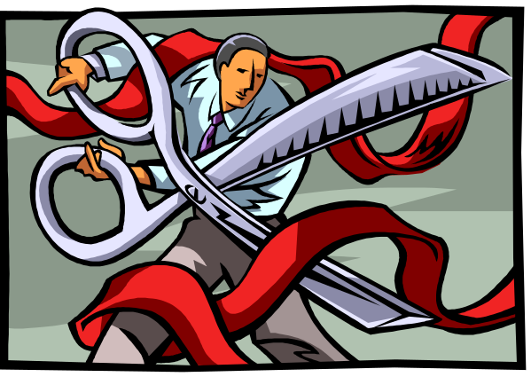


The Value of Modeling
Manage Complexity
Mitigate Risk
Facilitate Communication
ARCH-6: UML Modeling with Enterprise Architect

Slide 4


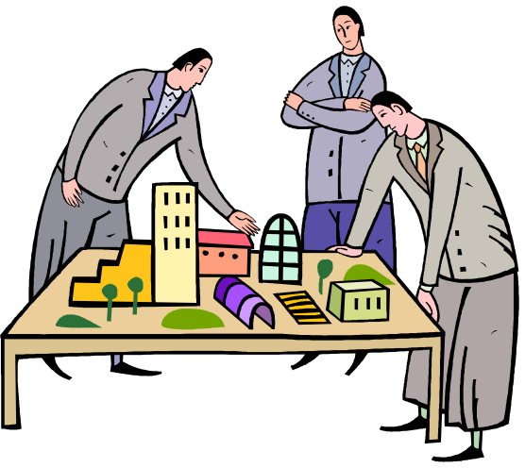
Modeling is Commonplace
ARCH-6: UML Modeling with Enterprise Architect

Slide 5
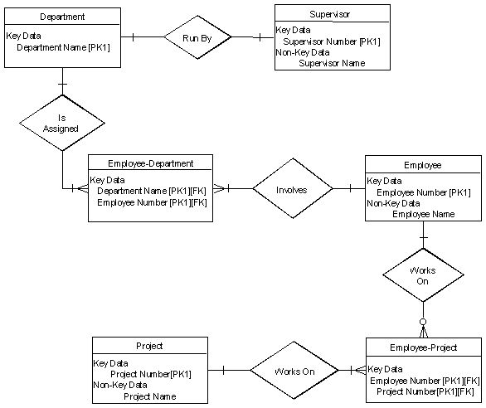


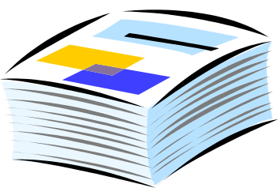
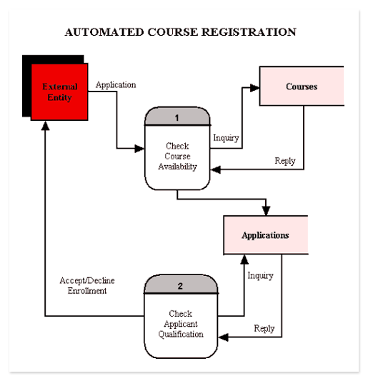

Software Development
Structure
Coding
Functionality
Behavior
Deployment
ARCH-6: UML Modeling with Enterprise Architect
Notes:
Use Case Diagram
Conceptual description of functionality
Class Diagram
Logical definition of structure
Sequence Diagram
Logical definition of behavior
Component Diagram
Physical definition of implementation details
Deployment Diagrams
Physical definition of location and topology

Slide 6
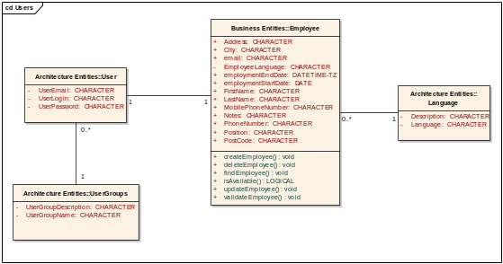
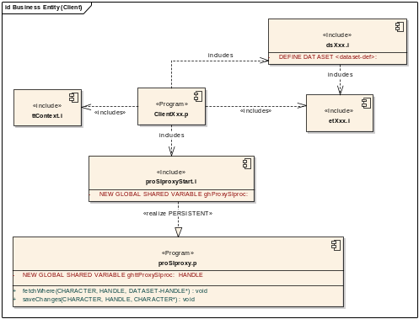
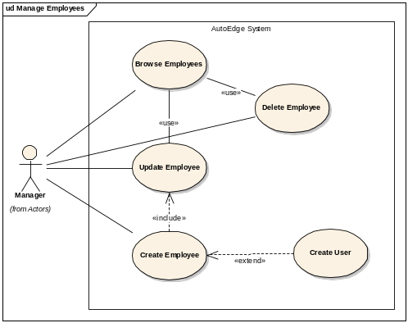
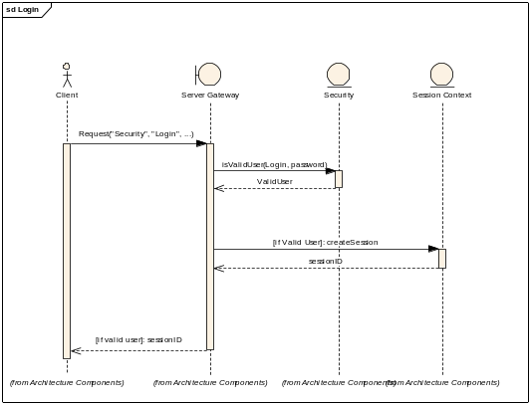
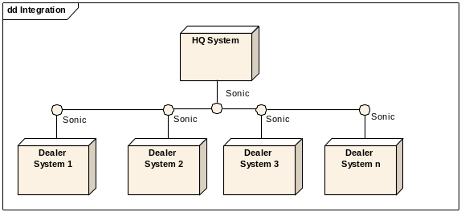
Software Development with UML
Logical View
Implementation View
Use Case View
Dynamic View
Deployment View
ARCH-6: UML Modeling with Enterprise Architect
Notes:
Use Case Diagram
Conceptual description of functionality
Class Diagram
Logical definition of structure
Sequence Diagram
Logical definition of behavior
Component Diagram
Physical definition of implementation details
Deployment Diagrams
Physical definition of location and topology

Slide 7

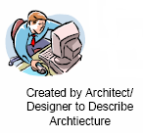
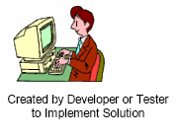
Model-Driven Architecture (MDA)
Computation-Independent Model
CIM >> PIM
Platform-Independent Model
PIM >> PSM
Platform-Specific Model
PSM >> Code
Code
Code
Code
ARCH-6: UML Modeling with Enterprise Architect

Slide 8
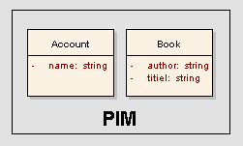
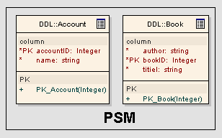
Model-Driven Architecture (MDA)
Define abstract Platform Independent Model (PIM)
Use PIM to derive Platform Specific Model (PSM)
Transform
ARCH-6: UML Modeling with Enterprise Architect

Slide 9
The Ultimate Goal
UML is a common language which can express functionality at different levels of abstraction
  Computation-Independent
  Platform-Independent
  Platform-Specific
From UML to software
Tools
ARCH-6: UML Modeling with Enterprise Architect

Slide 10
Agenda
UML Modeling with Enterprise Architect
The Value of Modeling
Enterprise Architect
Enterprise Architect and OpenEdge
Modeling for OpenEdge using Enterprise Architect
ARCH-6: UML Modeling with Enterprise Architect

Slide 11

Sparx Systems - Technology Partner Program
ARCH-6: UML Modeling with Enterprise Architect

Slide 12
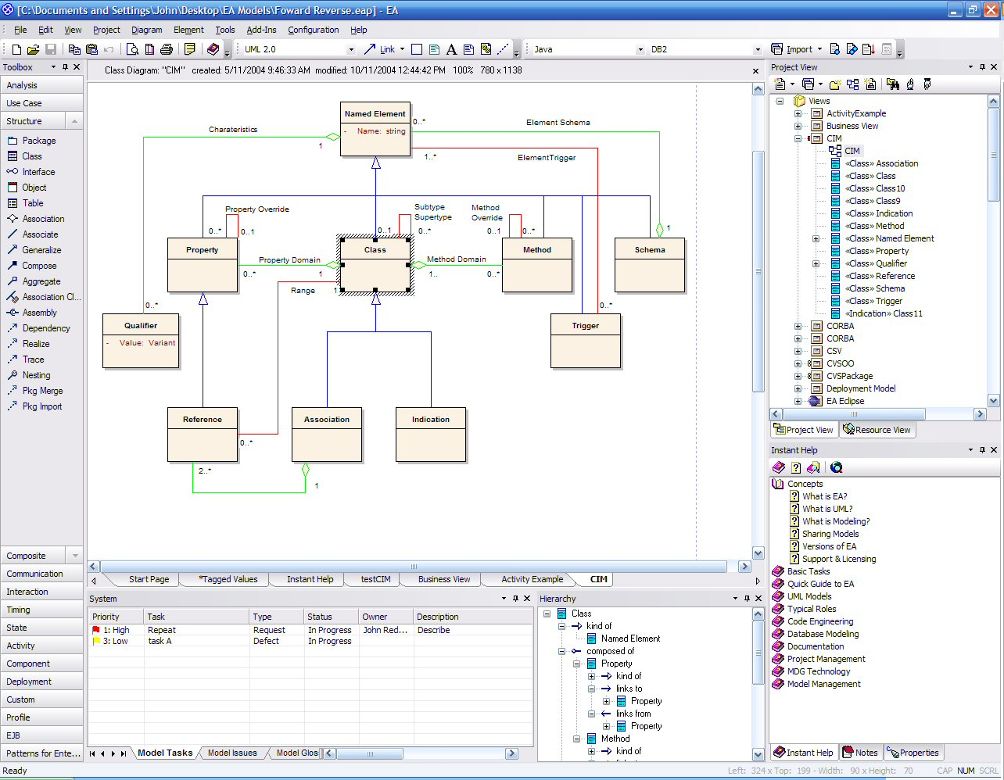
Enterprise Architect from Sparx Systems
ARCH-6: UML Modeling with Enterprise Architect

Slide 13
Enterprise Architect from Sparx Systems
Complete UML 2.0 compliance
Visualizes your application
Manages complexity
Generates and reverse engineers source code
Generates documentation
Customizable
Multi-user
Intuitive and easy to use
Cost-effective
ARCH-6: UML Modeling with Enterprise Architect

Slide 14
Agenda
UML Modeling with Enterprise Architect
The Value of Modeling
Enterprise Architect
Enterprise Architect and OpenEdge
Modeling for OpenEdge using Enterprise Architect
ARCH-6: UML Modeling with Enterprise Architect

Slide 15
OpenEdge and Enterprise Architect
Working Together
Enterprise Architect evaluated and selected
OpenEdge 10 Database support
  Data Modeling & Schema Engineering
  Contact & communications
Code Engineering
Visit to Sparx, Interoperability roadmap defined
Oct, 2003
Feb, 2005
May, 2005
Oct, 2005
Dec, 2005
Jan, 2006
ARCH-6: UML Modeling with Enterprise Architect
Notes:
Oct. ‘03 – ATG selects Enterprise Architect as UML tool for application transformation
May ’05 – Visit to Sparx Systems
OE10-EA integration roadmap formulated
Oct. ’05 – Alpha & beta testing of Enterprise Architect v6.0 which supports OpenEdge 10 RDBMS support
Dec ’05 – Alpha of Data Modeling & Schema Engineering for OpenEdge 10 RDBMS
Present – Work in progress to complete OE10-Enterprise Architect integration roadmap

Slide 16
Agenda
UML Modeling with Enterprise Architect
The Value of Modeling
Enterprise Architect
Enterprise Architect and OpenEdge
Modeling for OpenEdge using Enterprise Architect
ARCH-6: UML Modeling with Enterprise Architect

Slide 17
Modeling for OpenEdge using Enterprise Architect
OpenEdge 10 Database as Model Repository
OpenEdge 10 Data Modeling & Schema Engineering
Forward Engineering of OpenEdge 10 ABL Components
Forward & Reverse Engineering of OpenEdge 10 Object Oriented ABL
Real-Time Design-Time Integration between OpenEdge Architect and Enterprise Architect
ARCH-6: UML Modeling with Enterprise Architect
Notes:
OpenEdge 10 DBMS as model store
Data modeling/schema engineering
ABL code engineering
TempTables, ProDataSets, DAOs
Code engineering with object-oriented code

Slide 18
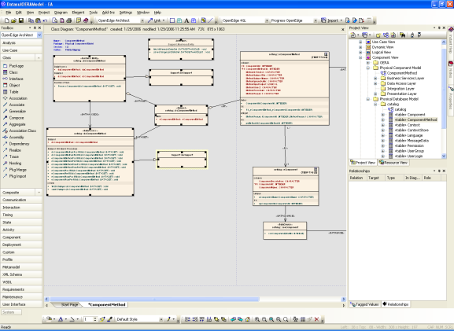
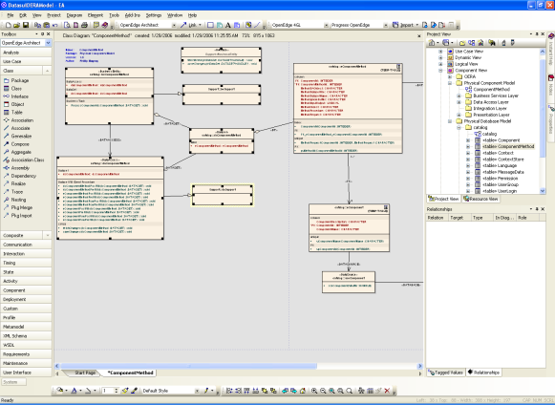

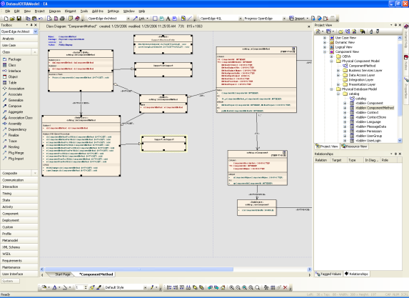
OpenEdge 10 Database as Model Repository
OpenEdge 10
DBMS
ARCH-6: UML Modeling with Enterprise Architect
Notes:
Store UML models in OpenEdge 10 database
Eliminates requirement for another database
Provides a convenient mechanism for storing models
Demonstrates the feasibility of using UML with OpenEdge

Slide 19
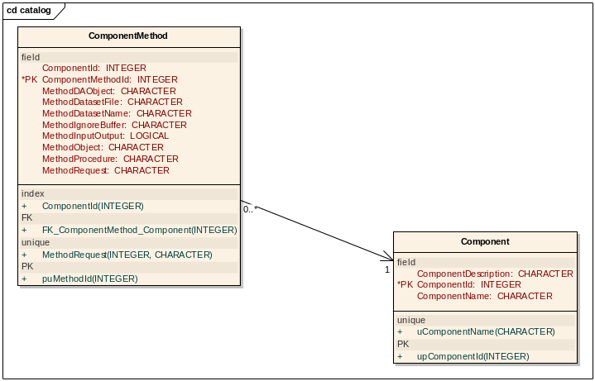

Data Modeling & Schema Engineering
schema.df
ARCH-6: UML Modeling with Enterprise Architect
Notes:
Create and model OpenEdge database schema using Enterprise Architect
.df -> UML model
UML model -> .df
Database modeling is an essential step to full application modeling

Slide 20

Data Modeling & Schema Engineering
ARCH-6: UML Modeling with Enterprise Architect

Slide 21
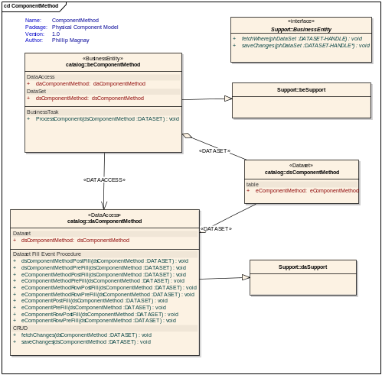
Code Engineering – ABL Components
*.p, *.i
Datasets
Business Entities
ARCH-6: UML Modeling with Enterprise Architect
Notes:
Start with a model and generate code
model to ABL
Start with ABL and generate a model
ABL to model
This will require significantly additional work
Temptables, datasets, data access objects

Slide 22
Code Engineering – ABL Components
ARCH-6: UML Modeling with Enterprise Architect

Slide 23
Code Engineering – Object-Oriented Classes
*.cls
ARCH-6: UML Modeling with Enterprise Architect
Notes:
Targeting object-oriented code
UML model -> object-oriented ABL code
Object-oriented ABL code -> model
Object-oriented code target is a more straightforward output for UML
More similarity to other languages
Easier in general to create object classes

Slide 24
Code Engineering – Object-Oriented Classes
ARCH-6: UML Modeling with Enterprise Architect

Slide 25
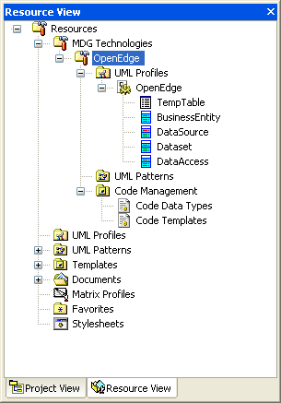
MDG Technology for OpenEdge
Enterprise Architect Projects for OpenEdge
  OpenEdge Data Types
  OpenEdge Code Templates
  UML Profiles for OpenEdge
  UML Stereotypes for OpenEdge
  UML Patterns for OpenEdge
ARCH-6: UML Modeling with Enterprise Architect

Slide 26
What’s next...?
D I S C L A I M E R
This talk includes information about potential future products and/or product enhancements.
What I am going to say reflects our current thinking, but the information contained herein is preliminary and subject to change. Any future products we ultimately deliver may be materially different from what is described here.
D I S C L A I M E R
ARCH-6: UML Modeling with Enterprise Architect

Slide 27
What’s next...?
No Promises…
Closer Link between Enterprise Architect and OpenEdge Architect at design-time
Alignment & Integration with Tools for Business Logic via XMI
Patterns and Practices
ARCH-6: UML Modeling with Enterprise Architect

Slide 28
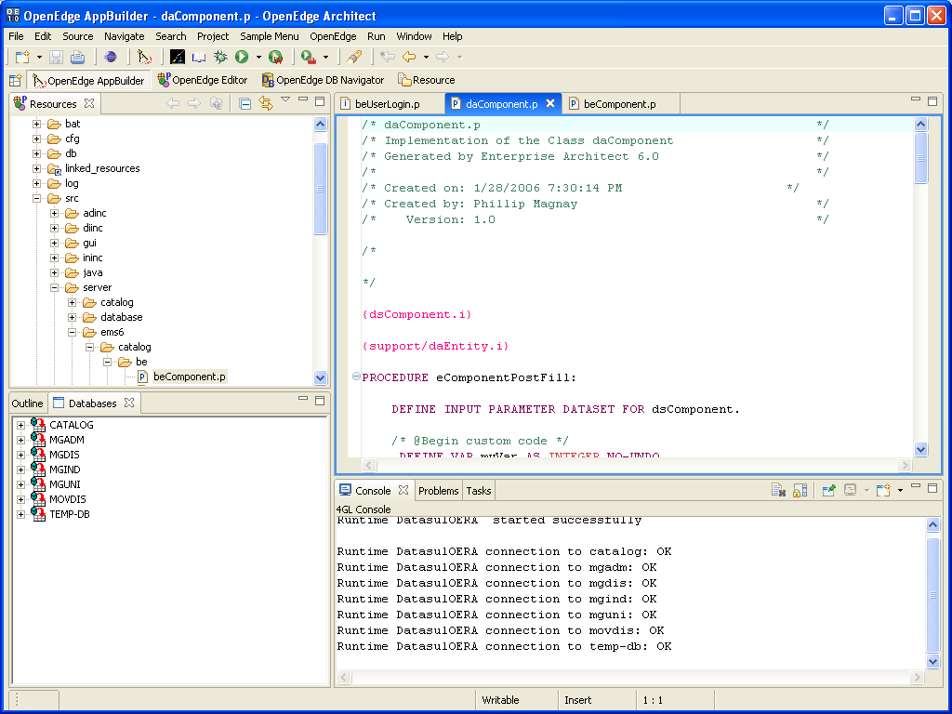
OpenEdge Architect & Enterprise Architect
ARCH-6: UML Modeling with Enterprise Architect
Notes:
Enterprise Architect interfaces with many different development environments
Interface is through MDG link
For full interoperability, Enterprise Architect requires link with OpenEdge Architect
MDG link will provide seamless integration for UML modeling in OpenEdge
Completion of roadmap

Slide 29

In Summary
UML provides a standard language to define systems
The result is higher productivity, better quality, and lower risk
OpenEdge and Enterprise Architect deliver the benefits of UML to OpenEdge developers
ARCH-6: UML Modeling with Enterprise Architect

Slide 30
For More Information, go to…
PSDN
  www.psdn.com
Sparx Systems
  www.sparxsystems.com
Relevant Exchange Sessions:
  ARCH-2: UML 101 - From Design to Implementation using UML
  ARCH-8: Implementing the OpenEdge Reference Architecture with OpenEdge 10.1
ARCH-6: UML Modeling with Enterprise Architect

Slide 31

Questions?
ARCH-6: UML Modeling with Enterprise Architect

Slide 32

Thank you for
your time
ARCH-6: UML Modeling with Enterprise Architect

Slide 33

ARCH-6: UML Modeling with Enterprise Architect

